Slide 1
Practical F: Build a triple-axis spectrometer!

Slide 2
TAS essentials
Spectrometer with 3 “axes”
1. Define incoming beam ki by a monochromator crystal (Bragg’s law)

Slide 3
TAS essentials
Spectrometer with 3 “axes”
2. A ‘sample-axis’ for zooming in on structural and dynamical aspects of the beam-sample interaction

Slide 4
TAS essentials
Spectrometer with 3 “axes”
3. Define outgoing beam kf by an analyser crystal (Bragg’s law)

Slide 5
TAS essentials
Spectrometer with 3 “axes”
As a start we will not add collimation or consider focusing…

Slide 6
TAS essentials
… with these 3 axes, we can study momentum- energy-transfer in the sample-beam interaction

Slide 7
Task 1: build a simple, non-optimised TAS (5 min)
Assume “thermal” source, e.g. parameters of ILL Thermal tube in Source_gen
Hint: use the mcdoc utility!
“Reactor-face” TAS
Mono:
@ 3 m
10x10 cm mono, PG002
No focusing
Sample pos:
Start with Incoherent scatterer (cylinder 7 cm tall, 1 cm dia)
2 m from mono
Analyser
@ 1m from sample
10x10 cm mono, PG002
No focusing
Detector
PSD
You can of course use other monitors along the way if you wish
Recommendation: Use Arm’s for the rotation (in- and out-going)
Recommendation: Use rotation-angles of (A1,A2) (A3,A4) (A5,A6)

Slide 8

Once built, perform scan
Set up for 2Å neutrons at both ana and mono
Perform a “rocking curve” i.e. A1 scan
Go Go Go!!
Clock is ticking!!

Slide 9
Let’s cheat a little: templateTAS
Lots of work done for you, including:
Reciprocal space calculator (from original TASmad code)
Automatic focusing options for both Mono and Ana

Slide 10
Plus special features for this course:
New samples added, with parameters
Single crystal related:
SX: Flag to indicate use of Single_crystal (default 0)
mosaic: SX mosaicity in arc minutes (default 30)
delta_d_d: SX lattice spacing variation (default 1e-3)
Eplus: additive energy term (SX is elastic only)
Res_sample related:
RES: Flat q/E resolution mode (default 0)

Slide 11
Run a scan
Download this BCC structure to your working folder
Perform an elastic scan around (100):
And an energy-scan (no inelastic contribution from sample)
Reduce mosaic and delta_d_d to “very small” values to mimic a delta function. Use to estimate elastic resolution.
mcrun templateTAS.instr QH=1.9,2.1 QK=0 QL=0 SX=1 Sqw_coh=BCC_fake.lau -N21 -n1e4
mcrun templateTAS.instr QH=2 QK=0 QL=0 EN=-1,1 SX=1 Sqw_coh=BCC_fake.lau -N21 -n1e4

Slide 12
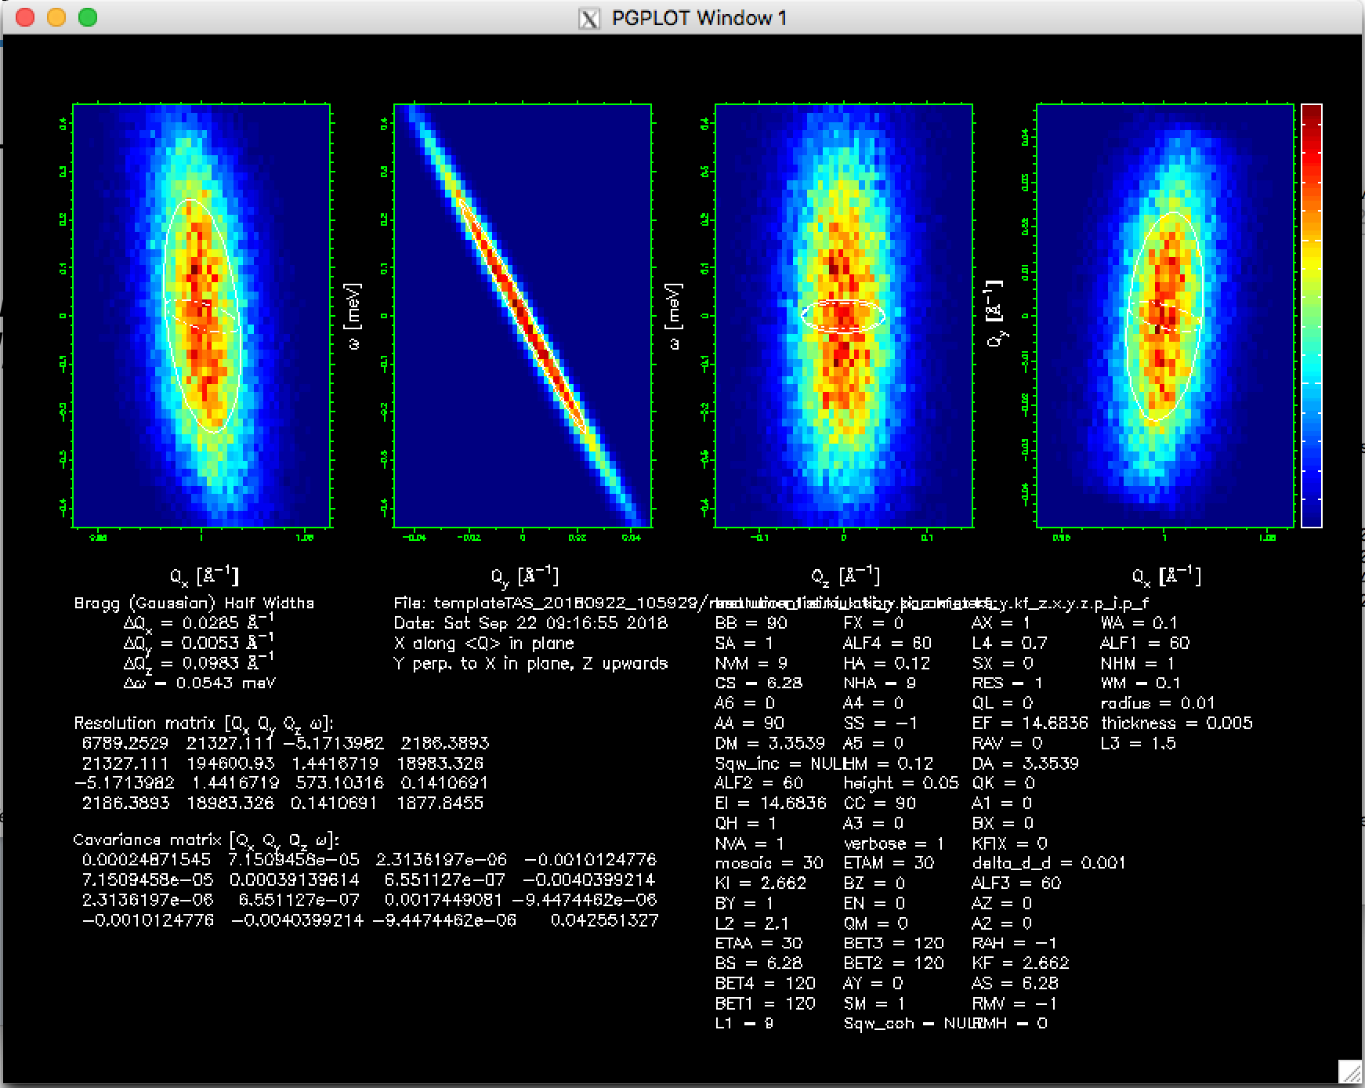
Run a simulation, e.g.
mcrun templateTAS.instr QH=2 EN=0 RES=1
Use the command line util mcreplot.pl to look at the resolution ellipsoid

